Slide 1

FLIGHT BOOKING PORTAL
Santosh Rengarajan
*

Slide 2
REQUIREMENTS
User sign-up & login feature.
Search Flight between the provided source and destination locations.
Book the user preferred flight Ticket and initiate payment.
Display the booked flight ticket in the user booking history.

Slide 3
TECHNOLOGY USED
HTML5, CSS3, Bootstrap & AngularJS 1.x for UI development.
NoSQL (MongoDB) Database.
Java J2EE project with Jersey Rest Full Framework for Backend development.
Tomcat 8.5 and Chrome web server as servers.

Slide 4
DEVELOPMENT PROCESS
Database structure designing & mock values insertion.
UI design.
Front end coding & testing.
Backend coding & testing.
Linking up the UI (Front-end) with Java Rest Full service (Back-end).
Reviews and Upgradation.

Slide 5
DATABASE
NoSQL databases are more scalable and provide superior performance.
MongoDB is easy to update and capable of storing large media files which could help in future upgradations.
Another major benefit of using MongoDB is simplified backend linking up the process.

Slide 6
DATABASE STRUCTURE
MongoDB Tables are constructed automatically by the Backend services.
Three Tables are constructed in MongoDB namely
  User Details
  Flight Details
  Booking Details
User Details & Booking Details Tables are dynamically created by user actions via java services.
In Flight Details table Mock data is appended manually using Mongo Booster.

Slide 7
UI DESIGN & DEVELOPMENT
UI is completely designed and developed without any TEMPLATE or private PLUGINS.
UI is designed from the perspective of providing a pleasant and commercial interface to the user.
The user can login or signup from any page without any mandatory initial login restriction.
Designed in black theme to adapt the future OLED displays and reduce power consumption.

Slide 8
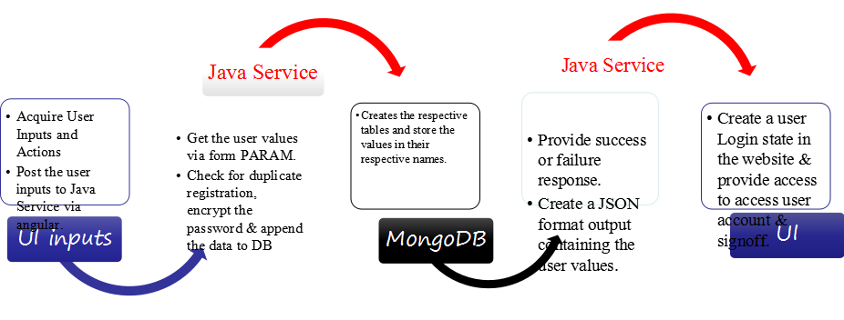
USER SIGNUP & SIGNIN PROCESS

Slide 9
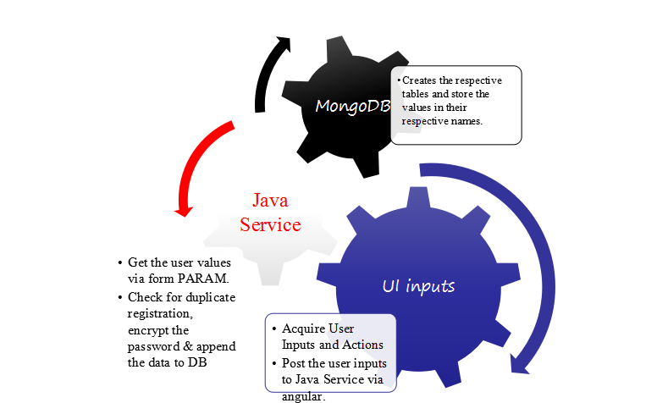
USER SIGNIN/SIGNUP PROCESS

Slide 10
FLIGHT SEARCH PROCESS
User Input
Java Process (DB hit)
MongoDB (values will be Searched)
Failure Response
Failure
IF
Success
Flight Detail Response
UI

Slide 11
TICKET BOOKING PROCESS
User Input
Java Process (DB hit)
MongoDB (Booking Details will be appended)
Failure Response
Failure
IF
Success
Ticket is generated in user account as Response
UI

Slide 12
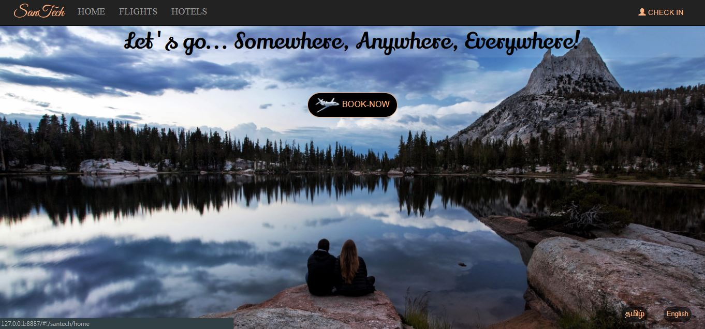
Home Page

Slide 13
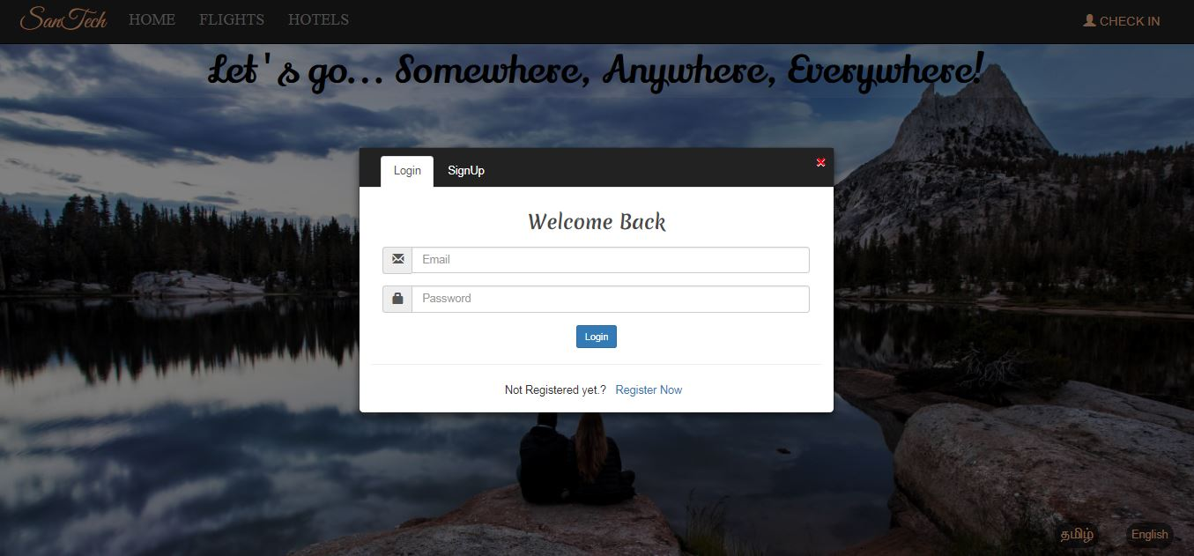
Sign in View

Slide 14
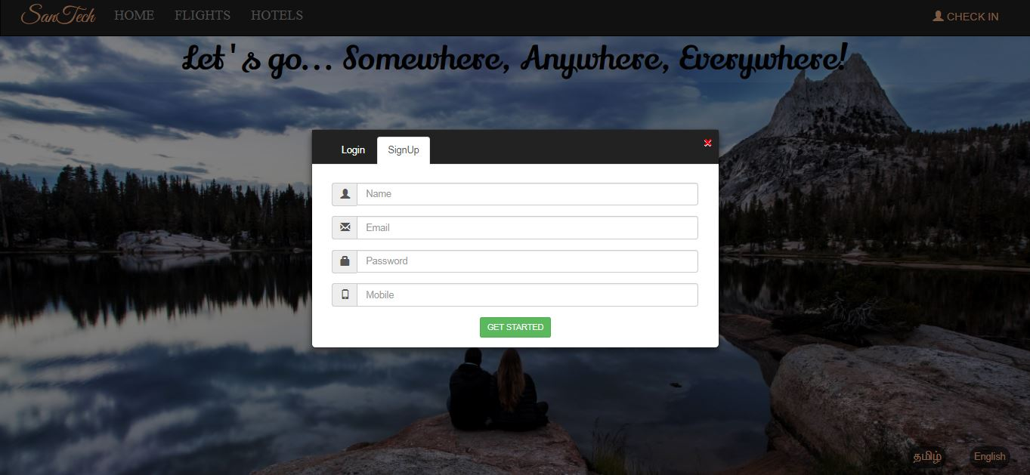
Sign up view

Slide 15
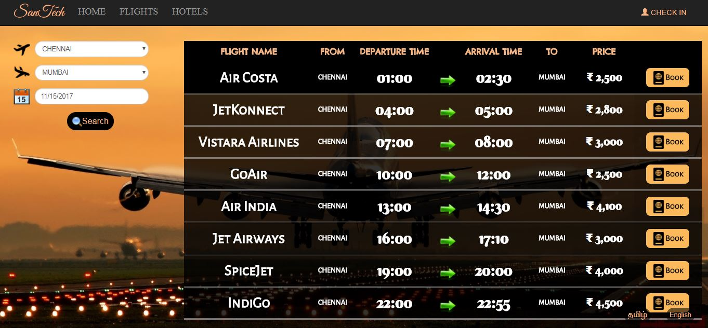
Flights Search Portal

Slide 16
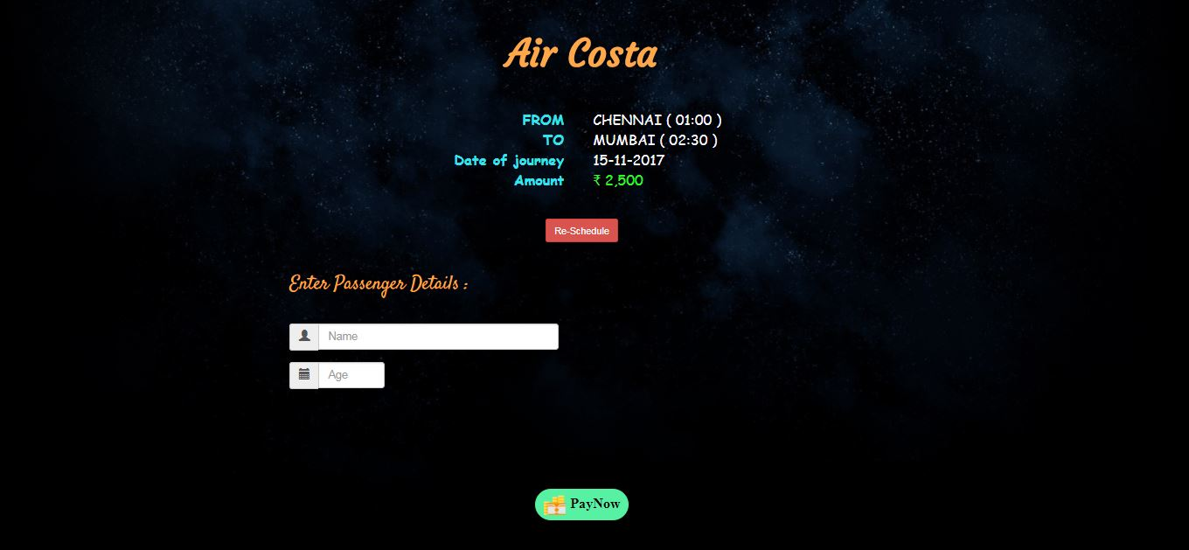
Passenger Details Portal

Slide 17
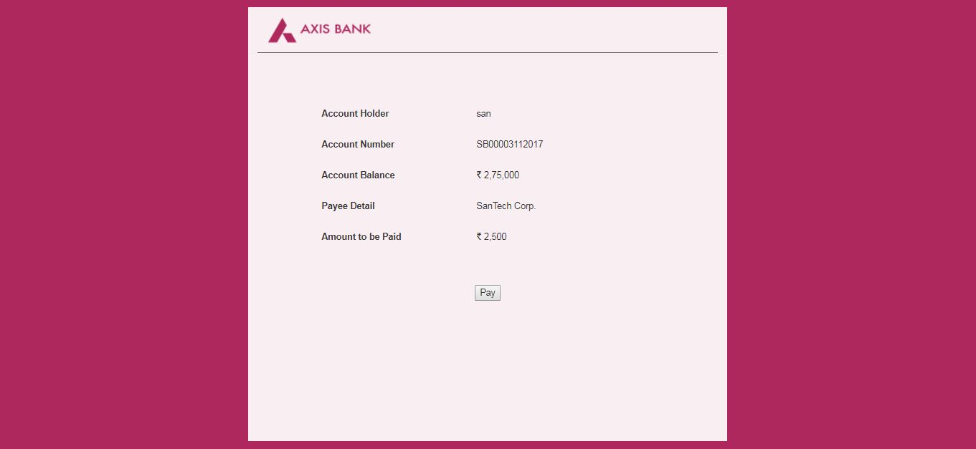
Mock Payment Portal

Slide 18
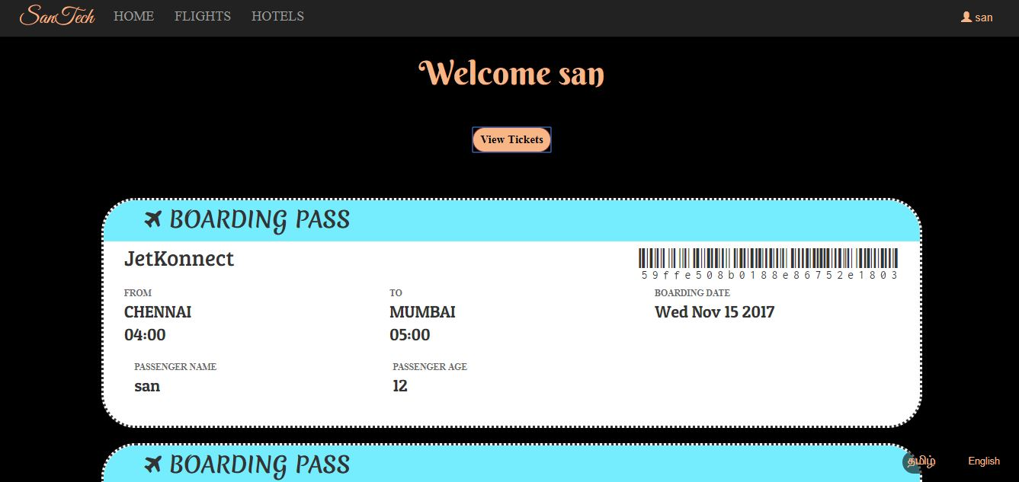
User Account & Tickets

Slide 19
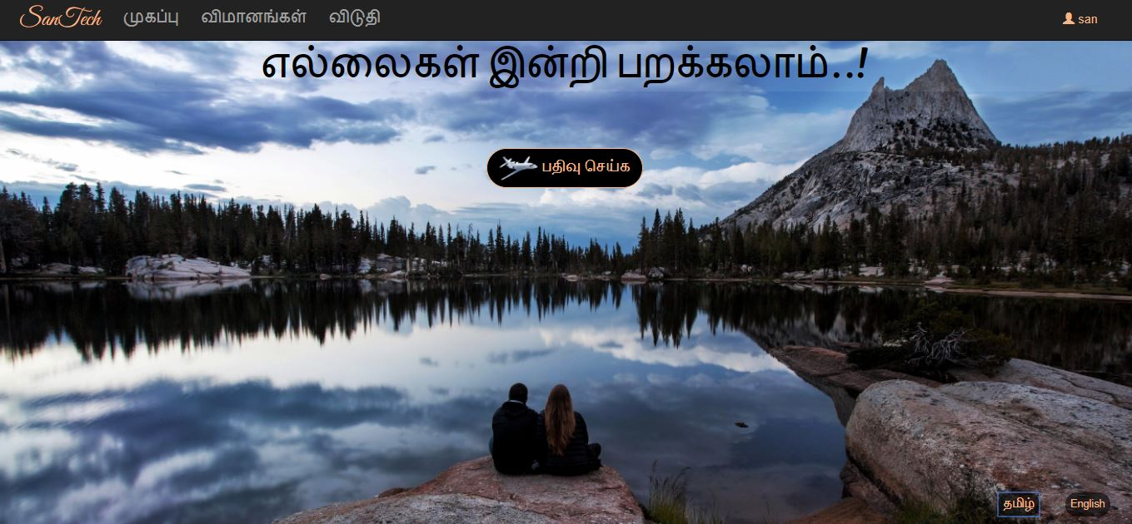
Secondary Language View

Slide 20



